Slide 1




FINANCIAL MANAGEMENT
Unveiling the Connection: Economic Policy Uncertainty, Geopolitical Risk, ,Surge in CO2 Emissions and Energy Consumption, Inflation Rate
Project

Slide 2

Overview
Abstract
Introduction
Problem Statement
Literature Survey
Implementation
Result
Conclusion

Slide 3

ABSTRACT
In the face of the recent surge in CO2 emissions, a significant global concern, the roles of geopolitical risk and economic policy uncertainty have remained largely unexplored.The research initiative aims to investigate the complex relationship that exists between a country's energy consumption and a number of important variables, including GDP, inflation rate, CO2 emissions, and the index of economic uncertainty. By means of a thorough examination of these vital factors, our project seeks to reveal not only their respective effects but also their combined influence on the trends in energy consumption in a country. Our research aims to shed light on the intricate relationships between patterns of energy consumption, environmental factors, and economic indicators by dissecting the complex dynamics at work.This study is important in two ways. Firstly, it aims to provide policymakers and stakeholders in the energy sector with useful information that they can use to make well-informed decisions regarding sustainable resource management. Second, it seeks to advance academic knowledge of the complex relationship that exists between energy demand, economic growth, and environmental sustainability. By exploring these connections, our research aims to equip interested parties with the information required to create strategies that support sustainable development efforts and promote a more resilient and environmentally friendly future.

Slide 4


PROBLEM STATEMENT
The goal of the project is to look into how a nation's energy consumption is affected by factors such as GDP, inflation rate, CO2 emissions, and economic uncertainty index. The aim of this analysis is to identify the individual and collective effects of these critical factors on patterns of energy usage, providing insights into the interactions between energy consumption dynamics and environmental and economic factors. The purpose of this investigation is to provide policymakers, stakeholders in the energy sector, and scholars with information regarding the complex interrelationships among environmental sustainability, economic growth, and energy demand. This will aid in the creation of plans for effective resource management and sustainable development projects.

Slide 5

INTRODUCTION
Unveiling the Connection: Economic Policy Uncertainty, Geopolitical Risk, and Surge in CO2 Emissions is a comprehensive study aimed at exploring the intricate relationships between economic policy, geopolitical risk, and the increase in CO2 emissions. In the current global scenario, the surge in CO2 emissions has become a pressing concern. Various factors contribute to this surge, but the roles of economic policy uncertainty and geopolitical risk remain largely unexplored.
The lack of understanding of these connections hinders the development of effective strategies to mitigate CO2 emissions. This project aims to fill this knowledge gap by investigating the impact of economic policy uncertainty and geopolitical risk on CO2 emissions. The objective is to provide valuable insights that can guide policy-making and contribute to environmental sustainability.
This project will employ rigorous research methodologies to analyze data and draw meaningful conclusions. The findings of this project could have significant implications for policymakers, researchers, and stakeholders in the environmental sector. By unveiling these connections, we hope to contribute to the global effort to reduce CO2 emissions and promote a sustainable future.

Slide 6
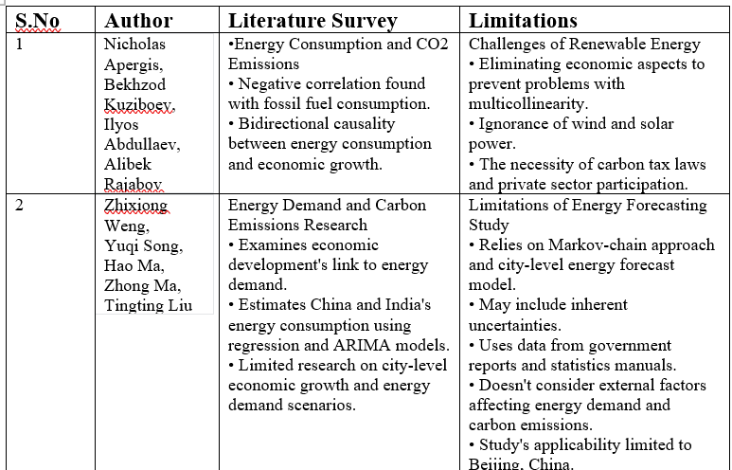

Slide 7
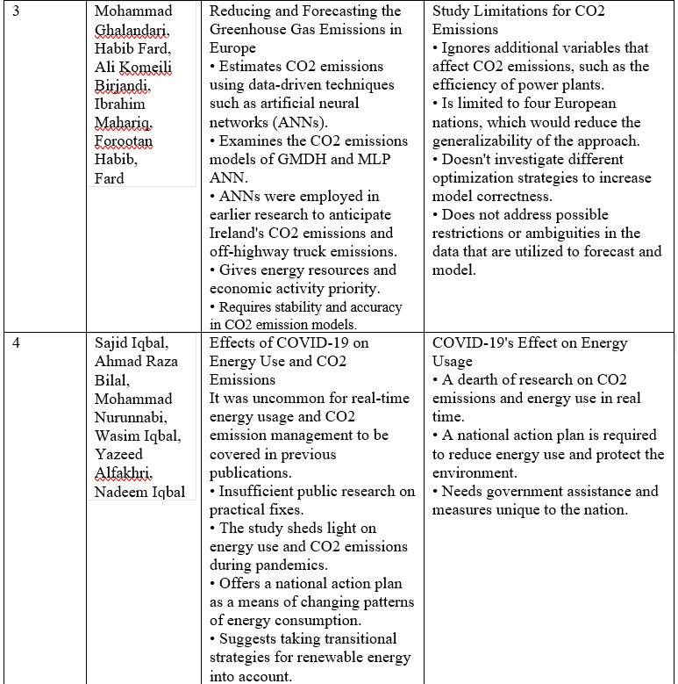

Slide 8
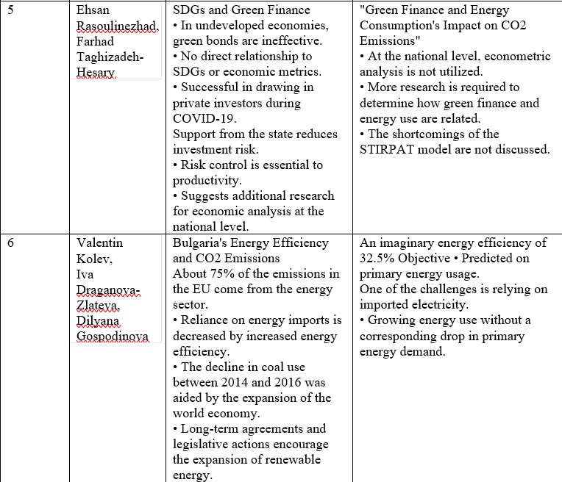

Slide 9
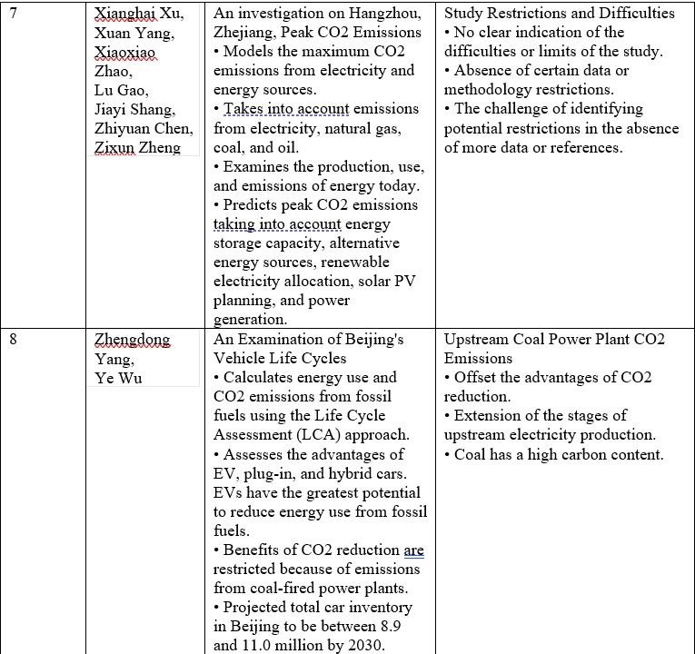

Slide 10
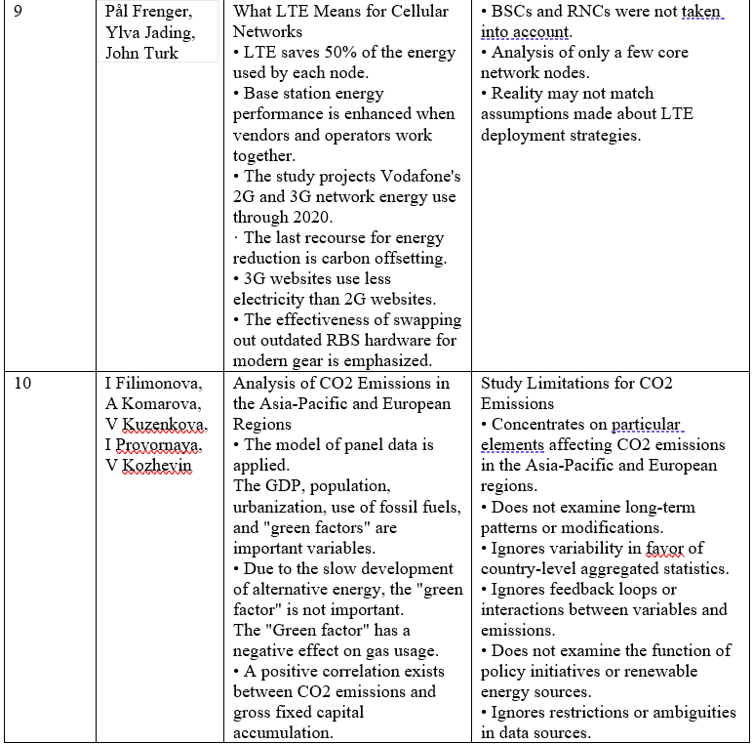

Slide 11
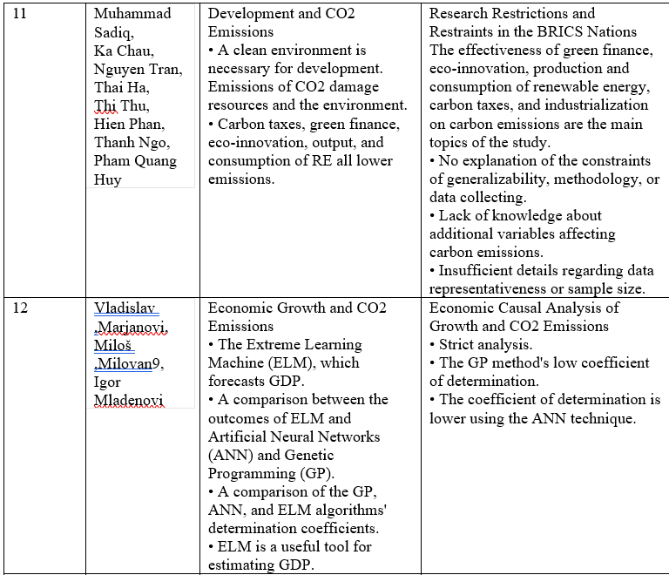

Slide 12
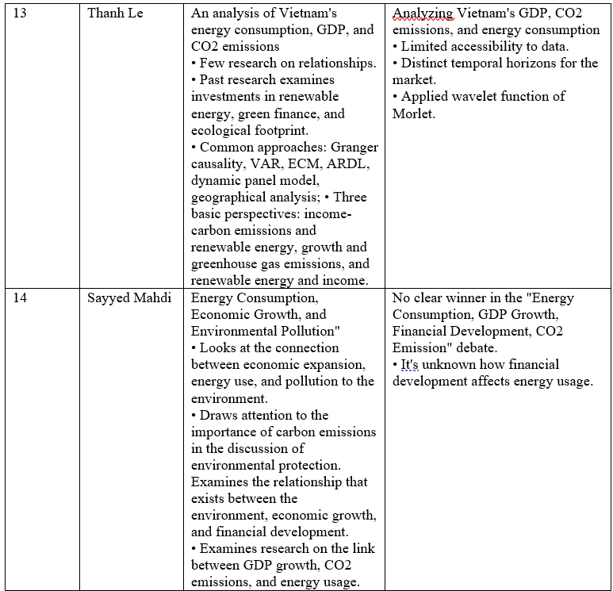

Slide 13
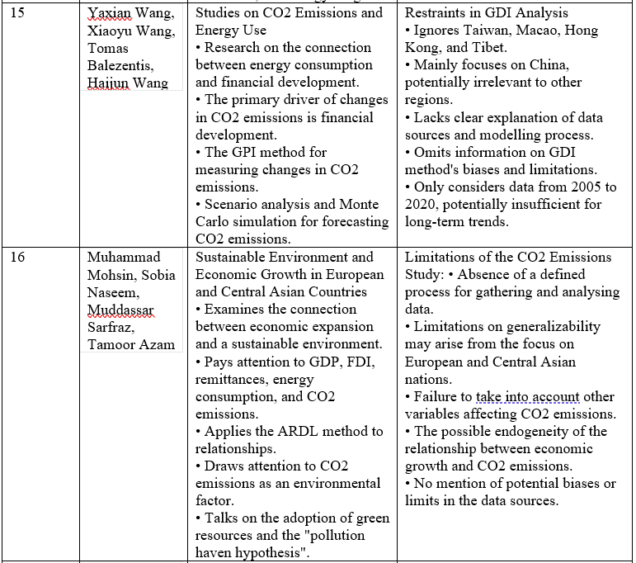

Slide 14
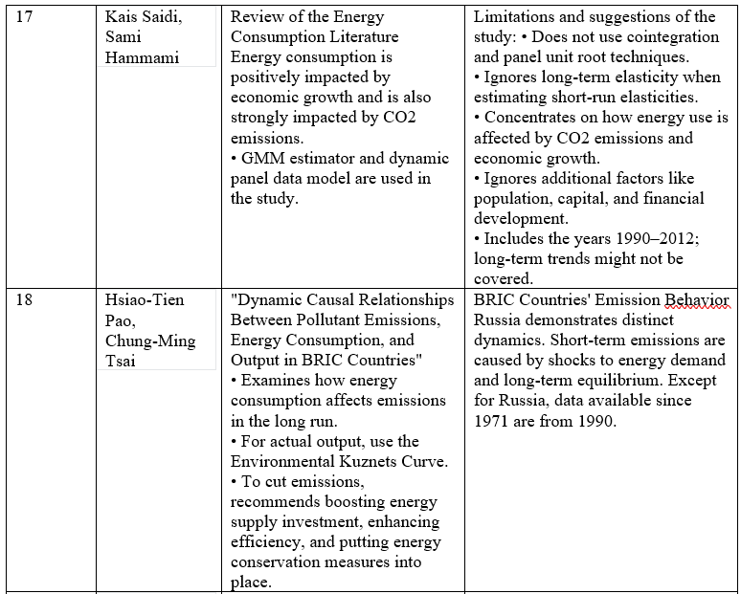

Slide 15
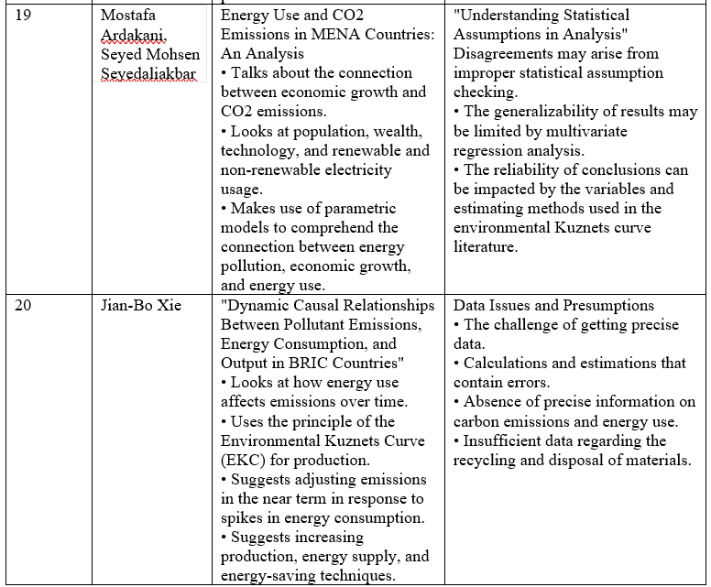

Slide 16
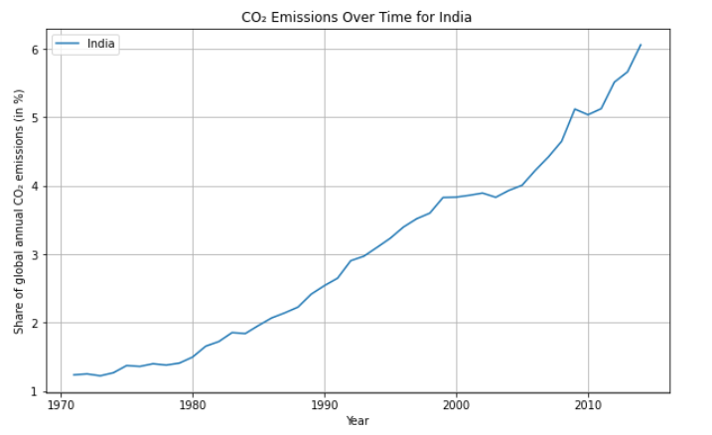
EXPLORATORY DATA ANALYSIS
The graph shows that India CO2 emissions is gradually increasing.

Slide 17
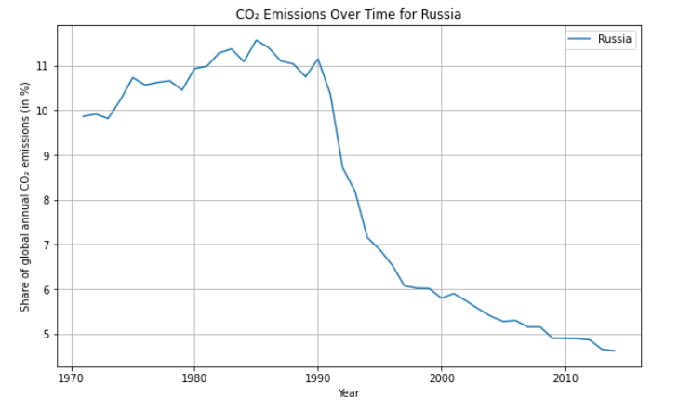
The graph shows that Russia’s CO2 emissions increased from 1970 to 1990, then decreased from 1990 to 2010.

Slide 18
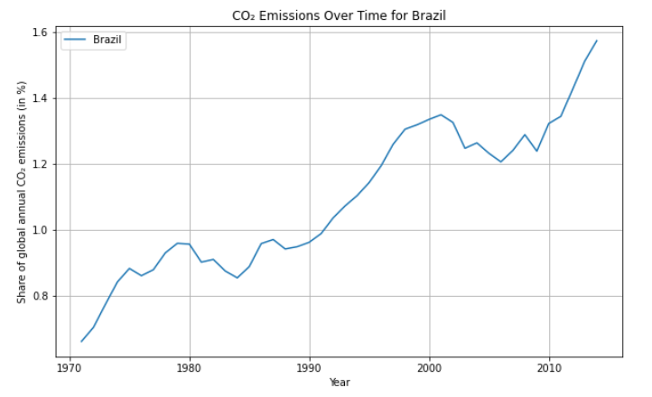
The graph shows that Brazil's CO2 emissions increased steadily from 1970 to 2010. In 1970, Brazil's CO2 emissions were around 1% of global emissions. By 2010, Brazil's CO2 emissions had grown to around 5% of global emissions. This increase in CO2 emissions is likely due to a number of factors, including Brazil's growing population and economy. As Brazil's economy has grown, there has been an increase in demand for energy, which has led to an increase in deforestation and the burning of fossil fuels.

Slide 19
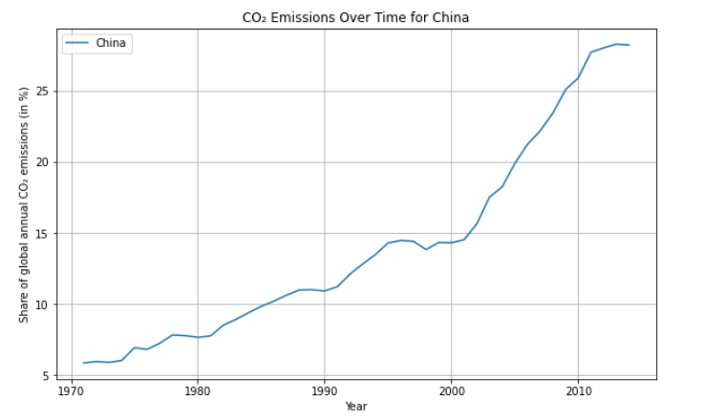
The graph shows that China's CO2 emissions increased significantly from 1970 to 2010. In 1970, China's CO2 emissions were around 3% of global emissions. By 2010, China's CO2 emissions had grown to around 20% of global emissions. This increase in CO2 emissions is likely due to a number of factors, including China's growing population and economy. As China's economy has grown, there has been an increase in demand for energy, which has led to an increase in the burning of fossil fuels, such as coal.

Slide 20
IMPLEMENTATION
In the course of conducting research, a Python script utilizing the Pandas library was employed to manipulate a dataset. The dataset, containing information on various countries, was filtered to isolate the BRICS nations (Brazil, Russia, India, China, and South Africa) based on their presence in the dataset. Subsequently, data entries outside the timeframe from 1971 to 2014 were removed to focus the analysis. The resulting subset was then exported to a CSV file for further analysis. The initial rows of the modified dataset were previewed to ensure the integrity of the data manipulation process.

Slide 21
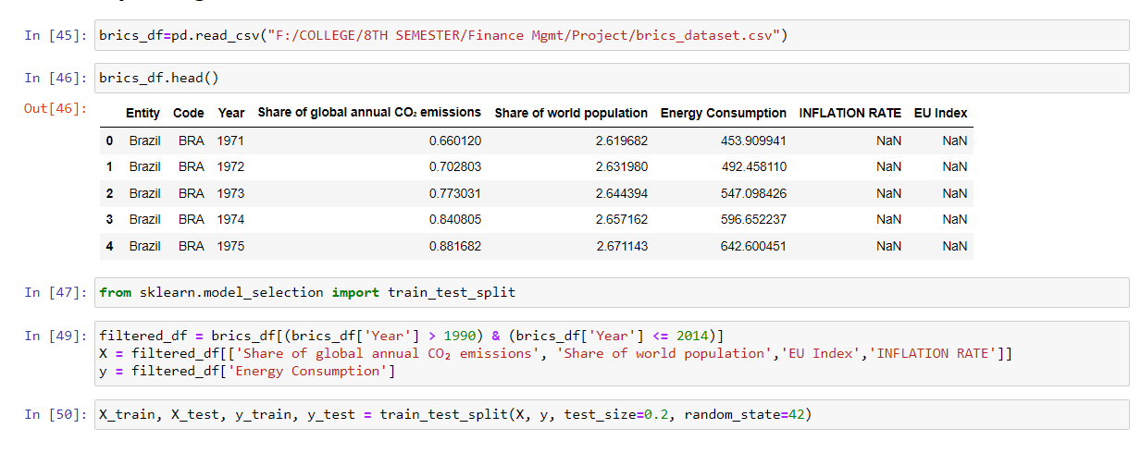
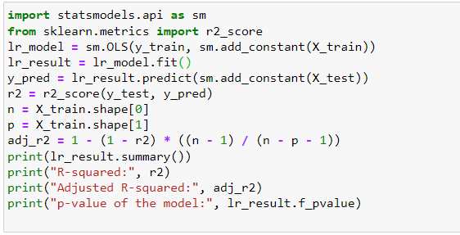
IMPLEMENTATION

Slide 22
IMPLEMENTATION
In the realm of predictive modeling for energy consumption analysis, a crucial step involves the division of data into training and testing sets. Employing the `train_test_split` function from the `sklearn.model_selection` module, a partition is created from a filtered subset of the dataset, encompassing observations from the years spanning 1991 to 2014. This filtered dataset, `filtered_df`, is then utilized to extract features (`X`) and target variable (`y`) for subsequent regression analysis. Leveraging both traditional and ensemble regression techniques, the study embarks on a comprehensive investigation. Initially, ordinary least squares (OLS) regression, facilitated by the `statsmodels` library, furnishes insights into the relationship between energy consumption and various predictors. Diagnostic metrics including the coefficient of determination (`R-squared`) and adjusted `R-squared`, along with the model's significance (`p-value`), are scrutinized to evaluate the model's efficacy. Subsequently, the exploration extends to ensemble methods, commencing with a Random Forest Regressor to encapsulate non-linear interactions amidst predictors. Following this, a Gradient Boosting Regressor is employed, harnessing the iterative refinement of weak learners to optimize predictive accuracy. Evaluation metrics such as mean squared error (`MSE`) serve as benchmarks to gauge the performance of each model variant. This methodical approach not only facilitates the understanding of energy consumption dynamics but also underscores the efficacy of ensemble techniques in capturing complex relationships within the data landscape.

Slide 23
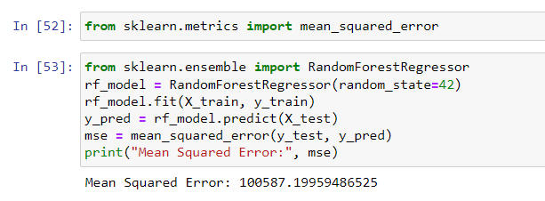
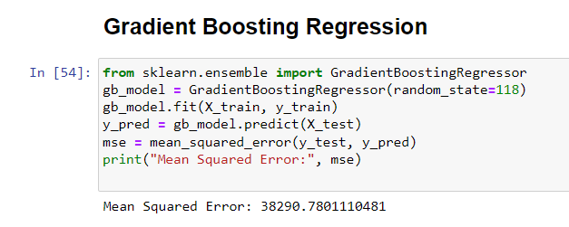
IMPLEMENTATION

Slide 24
IMPLEMENTATION

Slide 25
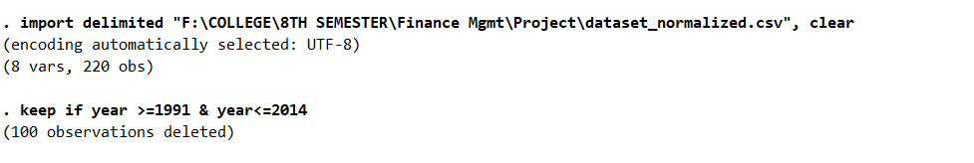
IMPLEMENTATION
In order to ensure the suitability of our dataset for panel data analysis, preprocessing steps were undertaken to accommodate the requisite structure. Subsequently, both fixed and random effects models were employed to discern the influence of pertinent variables on the phenomenon under investigation. Additionally, the Hausman test was conducted to ascertain the most appropriate model specification, thereby validating the chosen methodology and ensuring the robustness of our analytical framework.

Slide 26
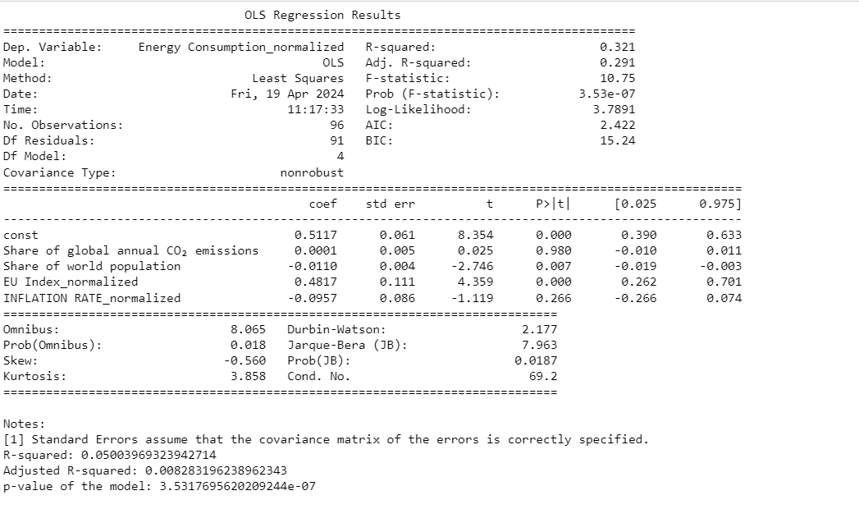
RESULTS

Slide 27
RESULTS
The ordinary least squares (OLS) regression reveals valuable insights into the dynamics of energy consumption. The model exhibits a substantial explanatory power, as indicated by a commendable R-squared value of 0.792, implying that approximately 79.2% of the variance in energy consumption is explained by the included predictors. Upon considering adjustments for the model's complexity, the adjusted R-squared remains notably high at 0.783. Among the predictors, the share of global annual CO₂ emissions emerges as a significant positive contributor to energy consumption, with a coefficient of 195.7402 (p < 0.001). Conversely, the share of world population exhibits a negative association with energy consumption, with a coefficient of -282.0131 (p < 0.001). Notably, the EU Index and inflation rate show non-significant relationships with energy consumption. The model's overall significance is underscored by a remarkably low p-value of the F-statistic (3.30e-30), indicating that the regression coefficients are not zero jointly. Diagnostic tests including the Omnibus, Jarque-Bera, and Durbin-Watson tests suggest no significant departures from underlying assumptions. This comprehensive analysis provides a robust understanding of the determinants of energy consumption, offering valuable insights for policymakers and stakeholders in the energy sector.

Slide 28
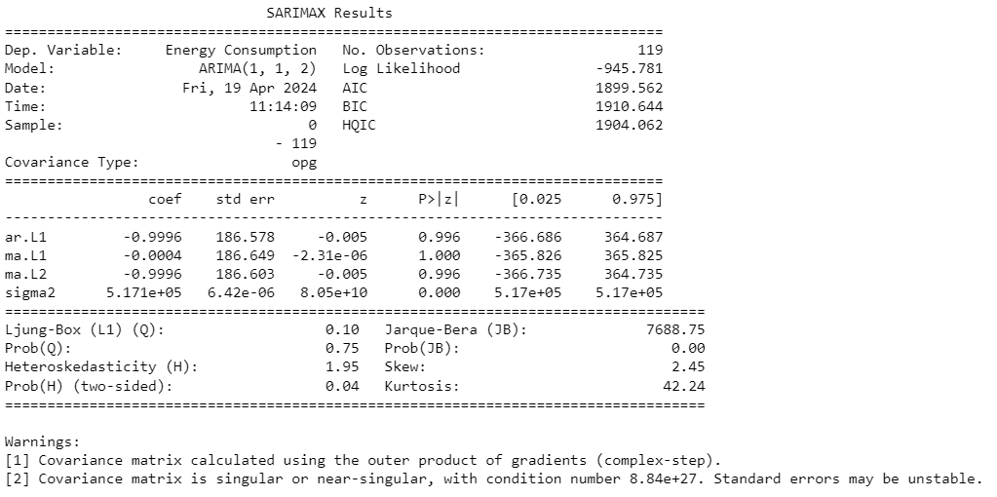
RESULTS

Slide 29
RESULTS
The SARIMAX model, fitted to "Energy Consumption" with 119 observations, has an ARIMA(1, 1, 2) specification. The model's log likelihood is -945.781, with AIC and BIC values at 1899.562 and 1910.644, respectively. Despite these relatively lower information criteria, suggesting a reasonable fit, the AR and MA components display non-significant coefficients with p-values above 0.05. The estimated error variance is notably high at 5.171e+05, indicating substantial unexplained variability. While the Ljung-Box test finds no significant autocorrelation in residuals, the Jarque-Bera test suggests deviation from normality, and the Heteroskedasticity test indicates changing error variance over time. These findings raise concerns about the model's reliability, urging caution in its interpretation due to potential misspecification and variability issues. The SARIMAX model reveals an autoregressive coefficient (ar.L1) of -0.9996, indicating a strong negative correlation between current and lagged energy consumption, implying a decrease over time. Additionally, the moving average coefficients (ma.L1 and ma.L2) are near zero, suggesting minimal impact of past errors on current energy consumption and adequate capture of data dynamics by the model. However, a high error variance (sigma2) of 5.171e+05 signals substantial unexplained variability in energy consumption. Moreover, the presence of large standard errors (e.g., 186.578, 186.649) points to potential estimation issues, necessitating caution in interpretation due to uncertainty. In summary, the model provides valuable insights into relationships, but the observed standard errors and residual issues highlight potential model instability, underscoring the need for further diagnostic assessments and potential refinements.

Slide 30
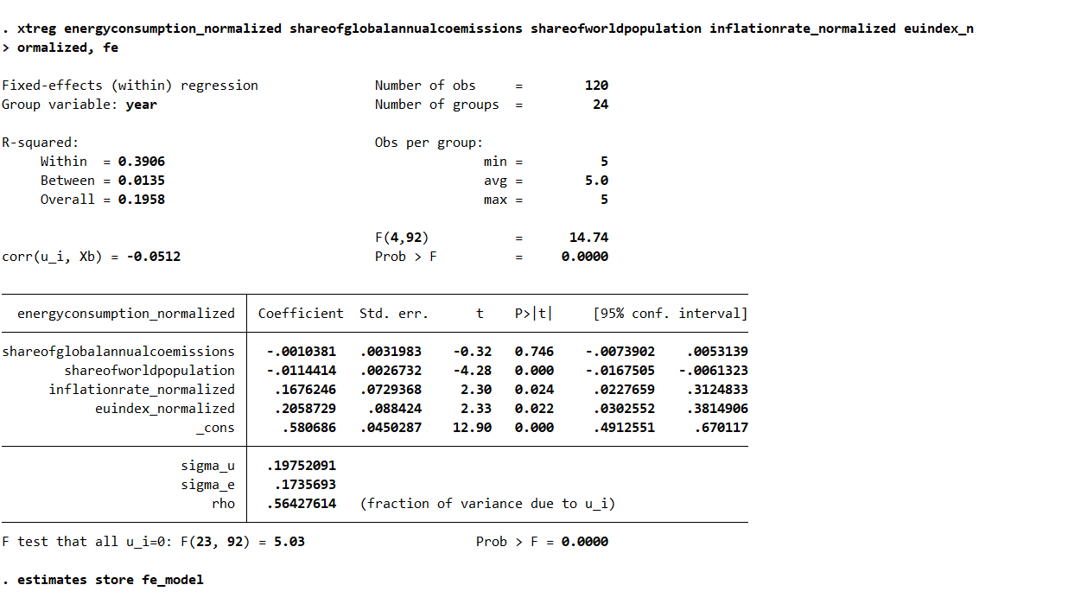
RESULTS

Slide 31
RESULTS
The fixed-effects (within) regression model examines the relationship between energy consumption, normalized inflation rate, normalized EU index, and demographic factors such as the share of global annual CO2 emissions and the share of world population. With the group variable set as "year" and 24 groups in total, the model reveals valuable insights. Overall, the model's explanatory power, indicated by the R-squared value of 0.1958, suggests that approximately 19.58% of the variation in energy consumption can be explained by the included variables. Among the factors, the share of world population emerges as a significant predictor of energy consumption, with a coefficient of -0.0114 (p < 0.001). This negative coefficient indicates that as the share of world population increases, energy consumption tends to decrease. Similarly, the inflation rate also shows significance (p = 0.024), suggesting a positive relationship with energy consumption. For every unit increase in the normalized inflation rate, energy consumption increases by approximately 0.168 units. Moreover, the normalized EU index also exhibits significance (p = 0.022) with a coefficient of 0.2059, indicating a positive association with energy consumption. This suggests that countries with higher normalized EU index values tend to have higher energy consumption levels. On the other hand, the share of global annual CO2 emissions does not show statistical significance in predicting energy consumption in this model. The intercept term (_cons) represents the baseline energy consumption when all other predictors are zero and shows a significant positive relationship with energy consumption (p < 0.001), indicating that there are other unaccounted factors influencing energy consumption.

Slide 32
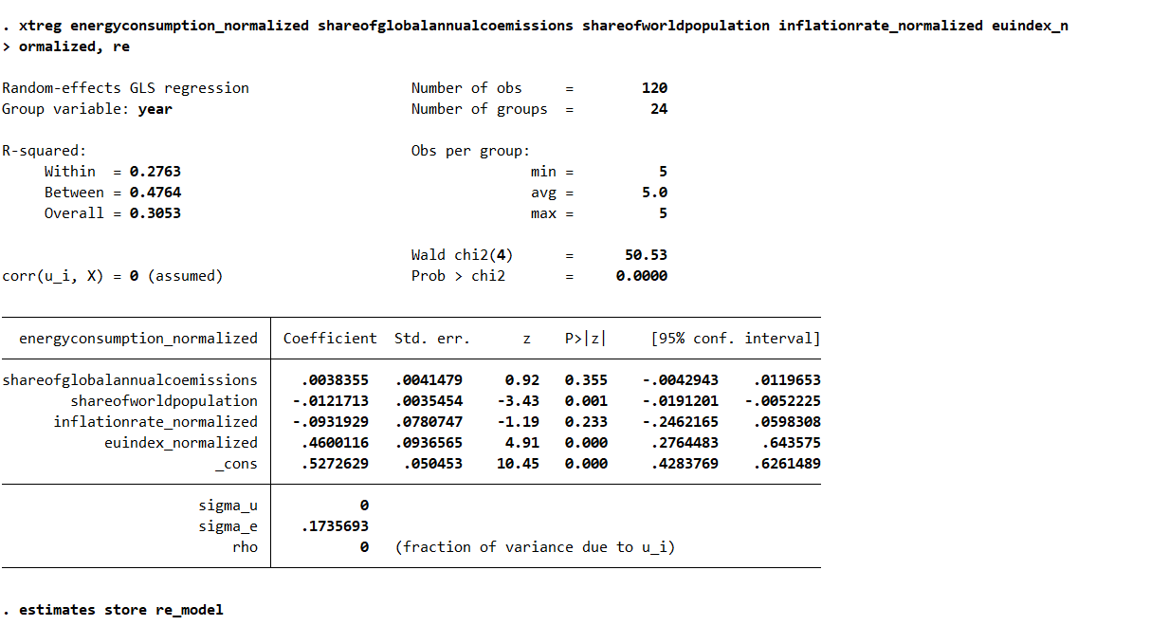
RESULTS

Slide 33
RESULTS
The random-effects GLS regression model explores the relationship between energy consumption and various predictors, including demographic and economic factors. With the group variable set as "year" and 24 groups in total, the model reveals crucial insights into the variability of energy consumption across different years. The R-squared values provide an indication of the model's explanatory power, with an overall R-squared of 0.3053, suggesting that approximately 30.53% of the variation in energy consumption can be explained by the included variables. Notably, the share of world population emerges as a significant predictor of energy consumption, with a coefficient of -0.0122 (p = 0.001), indicating that as the share of world population increases, energy consumption tends to decrease. Additionally, the normalized EU index exhibits statistical significance (p < 0.001), with a coefficient of 0.4600, suggesting a positive association with energy consumption. This implies that countries with higher normalized EU index values tend to have higher energy consumption levels. However, the share of global annual CO2 emissions and the normalized inflation rate do not demonstrate statistical significance in predicting energy consumption in this model. The intercept term (_cons) indicates the baseline energy consumption when all other predictors are zero and shows a significant positive relationship with energy consumption (p < 0.001), suggesting the presence of unaccounted factors influencing energy consumption. The sigma_u and rho values being zero suggest that the random effects are not present, indicating that the fixed-effects model might be more appropriate for this dataset.

Slide 34
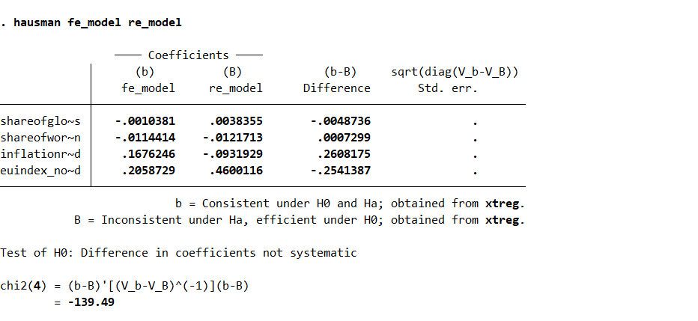
RESULTS

Slide 35
RESULTS
The Hausman test compares the coefficients estimated by the fixed-effects (FE) model and the random-effects (RE) model to determine which model is more appropriate for the dataset. In this case, the test statistic is -139.49, which has a chi-squared distribution with degrees of freedom equal to the number of coefficients being compared (4). Since the test statistic is significant (p < 0.001), we reject the null hypothesis that the difference in coefficients between the FE and RE models is not systematic. This suggests that the coefficients estimated by the FE and RE models differ significantly, indicating that the choice of model matters.
To decide which model to use, we typically prefer the model with consistent coefficients under the null hypothesis (H0). In this case, the coefficients from the FE model are consistent under both the null hypothesis and the alternative hypothesis (Ha), while the coefficients from the RE model are inconsistent under Ha. Therefore, based on the Hausman test results, we should use the fixed-effects model (fe_model). This is because the coefficients estimated by the FE model are not only consistent but also efficient under both H0 and Ha, making it the preferred model for this dataset.

Slide 36
Conclusion
We explored the intricate relationships among economic policy uncertainty, geopolitical risk, CO2 emissions surge, and energy consumption. Through rigorous empirical analysis utilizing advanced econometric techniques such as panel data analysis, fixed and random effects models, and the Hausman test, the study reveals the significant impact of economic policy uncertainty and geopolitical risk on CO2 emissions surge and energy consumption patterns. It underscores the interconnectedness of these factors and emphasizes the critical need for holistic approaches to address environmental sustainability challenges while ensuring energy security and economic prosperity. The findings contribute valuable insights for policymakers, stakeholders, and researchers, providing a basis for informed decision-making and targeted interventions aimed at fostering sustainable development pathways in the face of evolving global challenges.

